Slide 1

What is Linear Algebra and Its Importance?
Linear algebra is a branch of mathematics that deals with vectors, matrices, and
systems of linear equations. It plays a vital role in various fields such as engineering,
data analysis, and cryptography.

Slide 2


Introduction to Linear Algebra
1
Definition
Linear algebra is the study of vector spaces and linear mappings between them. It
deals with the linear equations and their representation in vector space using
matrices.

Slide 3
Basic Concepts in Linear Algebra
1
Vectors &
Vector Spaces
2
Matrices & Matrix
Operations
3
Systems
of Linear
Equations
Matrices are
rectangular arrays of
numbers or symbols.
Matrix operations
include addition,
subtraction,
multiplication, and
inversion.
A system of
Linear equations
consists of multiple
equations that need to
be solved
simultaneously.
Vectors are objects that
represent quantities
with both magnitude
and direction. Vector
spaces are sets of
vectors with specific
properties.

Slide 4

Applications of Linear Algebra
Engineering Applications
Linear algebra is considered a basic concept in the modern presentation of geometry. It is mostly used
in Physics and Engineering as it helps to define the basic objects such as planes, lines and rotations of
the object. It allows us to model many natural phenomena, and also it has a computing efficiency..
Data analytics and machine learning
Linear algebra forms the foundation of data analysis techniques and machine learning algorithms. Data
analytics and machine learning .It forms the backbone of machine learning algorithms, enabling operations
like matrix multiplication, which are essential to model training and prediction.Linear algebra techniques
dimensionality reduction, enhancing the performance of data processing and interpretation.

Slide 5

cryptography in Linear Algebra
cryptography (writing codes) we use linear in several geometrical crypto
systems. For example, some types of elliptic curve cryptography (ECC)
incorporate a series of matrix transformations as part of decryption and
encryption.

Slide 6

Advanced Topics in Linear Algebra
1
Eigenvalues & Eigenvectors
Eigenvalues represent scalar values that characterize the behavior of linear
transformations. Eigenvectors are special vectors associated with these eigenvalues.
2
Orthogonal Vectors & Orthogonal Projections
Orthogonal vectors are perpendicular to each other. Orthogonal projections involve projecting a vector onto a subspace.
3
Singular Value Decomposition
Singular value decomposition (SVD) is a factorization of a matrix into three matrices, which aids in various applications like image compression and data analysis.

Slide 7
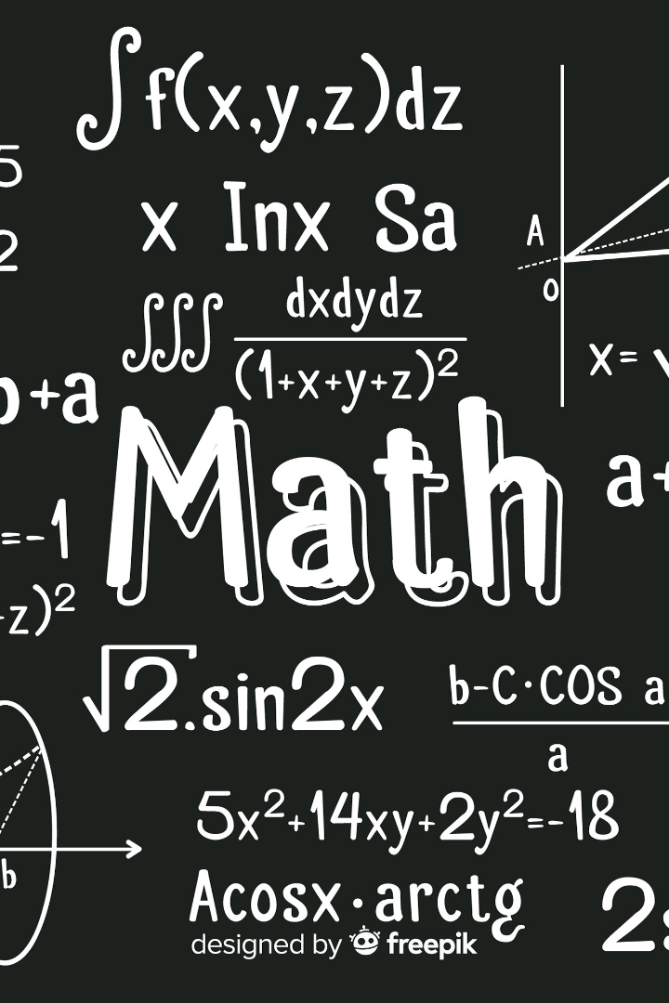
Exploring Group Theory and Algebraic Structures
Discover the fascinating world of group theory, abelian groups, rings, and fields.
Dive into the fundamental concepts and their applications in various
mathematical fields.

Slide 8
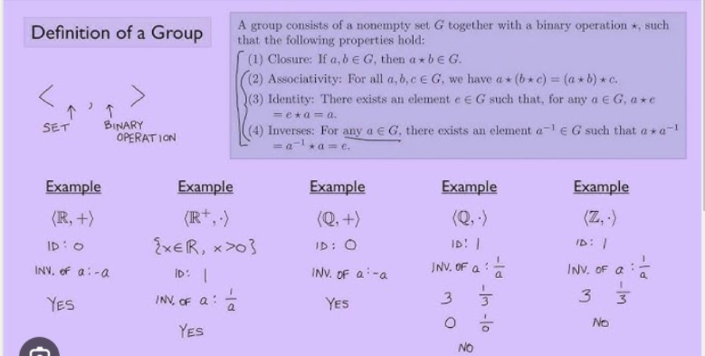
The Basics of Group Theory
1
Introduction to Groups
Understand the foundational
concepts of groups and their significance
in mathematics.
2
Definition of Group
A group is a finite or infinite set of elements
together with a binary operation (called the
group operation) that together satisfy the
four fundamental properties of closure,
associativity, the identity property, and the
inverse property.

Slide 9

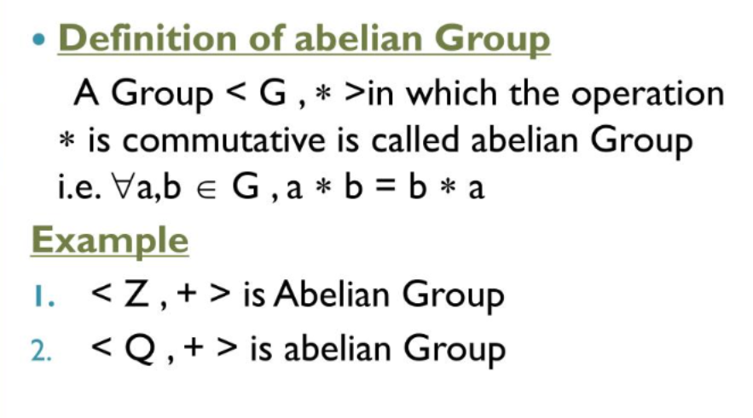
Unraveling Abelian Groups
1
Definition of Abelian Group
A group (G, o) is called
an abelian group if the group operation
o is commutative. If a o b = b o a ∀a,b∈
G holds then the group (G, o) is said to be
an abelian group. Abelian groups are also
known as commutative groups.
Example of Abelian Groups
Set of all integers(Z,+ , *).

Slide 10
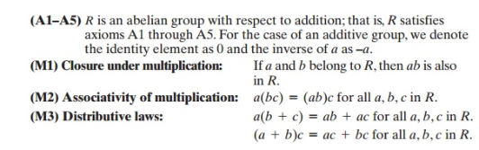
Unleashing the Power of Rings
Definition of Ring
A Ring is denoted by {R,+,*} is set of
elements with two binary operations called
addition and multiplication such that for all
a,b,c belongs to R.

Slide 11
Unlocking the Secrets of Fields
A field is a set F with two binary operators (or functions) + and * and with elements 0 and 1 such that:
Commutativity of addition: a+b=b+a
Associativity of addition: (a+b)+c=a+(b+c)
Additive identity: 0+a=a+0=a
Additive inverse: There exists an element b such for all a such that a+b=0
Commutativity of multiplication: ab=ba
Associativity of multiplication: (ab)c=a(bc)
Multiplicative identity: 1a=a1=a
Multiplicative inverse: There exists an element b for all nonzero a such that ab=1
Distributivity of multiplication over addition: a(b+c)=ab+ac

Slide 12
Examples of fields
The rational numbers Q
The real numbers R
The complex numbers C
The set of rational polynomial functions

Slide 13
What happens if linear algebra wasn’t there?
Impact on Science and Engineering:
No Tools for Data Analysis
Ex: PCA,SVD.
Loss in Computer Graphics and Image Processing
Impact on Quantum Mechanics
Coding Theory and Cryptography Challenges:

Slide 14

D.Deepthi Sri 23071A616 CSDS-A

